Slide 1

Renovation of an Existing Office Building in New Jersey
Reference to affiliation and logo ONLY permitted on first slide.
Seminar 12: Improving Existing Structures
Chris Preyor, Nihonsekkei,INC.
cpreyor@nihonsekkei.co.jp
Notes:
The first slide background may contain a company logo. Edit master title slide to add logo to first slide ONLY.

Slide 2
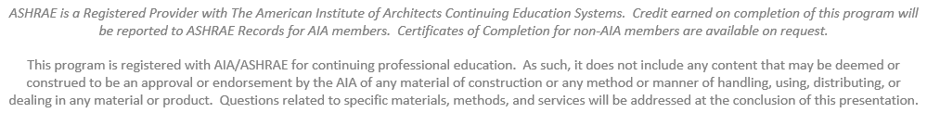
Learning Objectives & AIA Disclaimer
Describe the background of decarbonization in tenant office buildings in Japan and trends in environmental certification of renovated buildings.
Describe energy conservation methods to improve the environmental performance of existing buildings and how to create a path to ZEB achievement through case studies.
Describe the need to stop simple replacement and the importance of optimizing equipment capacity according to current usage.
Identify local renewable energy sources and analyze their operational performance.
Describe how to avoid commercialism in an ASHRAE presentation
Explain what happens when a commercialism violation occurs at an ASHRAE conference
This slide, including the AIA disclaimer below, must be included for all Seminars, Paper Sessions and Workshops. The slide must contain the four overall Learning Objectives for the session and you may also include any additional objectives that are specific to your presentation.

Slide 3
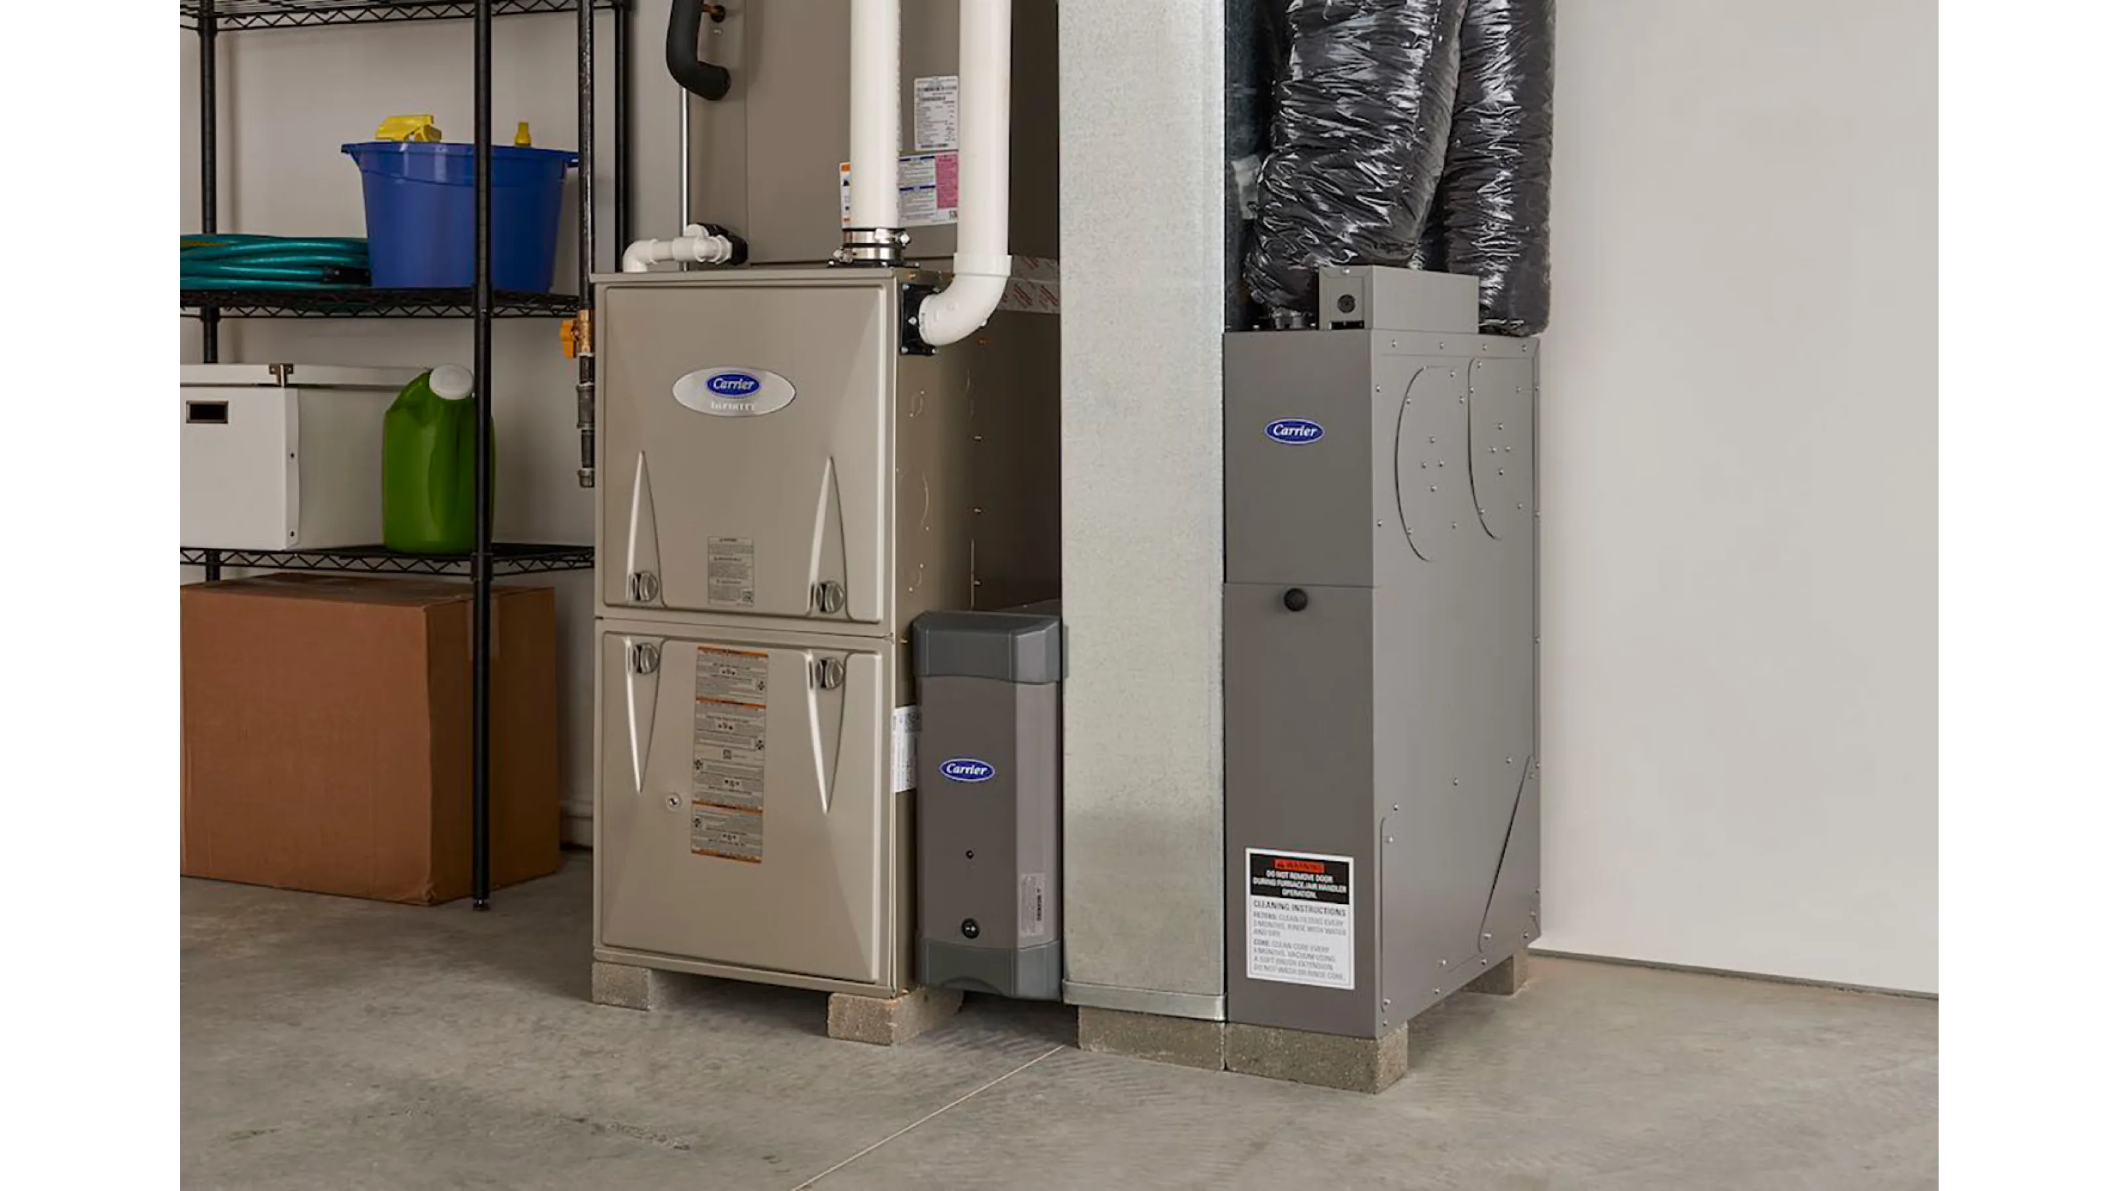


Do NOT Reference or display
trade names, logos or products of HVAC&R related organizations on ANY slide. Censor logos on photos.
American Standard is a trusted household name with reliable and affordable products.

Slide 4
Hyperlinks are NOT permitted on any slide. Text only URLs are allowed.
https://www.ashrae.org/
Okay
https://www.ashrae.org/
Not Okay
Direct fired absorption chiller (240RT x2 units) COP=1.01
Water cooling chiller(120RT x2 units) COP=4.69 (1.73)

Slide 5

Do NOT infer that ASHRAE
approves or endorses any product, software or system for any reason.
Direct fired absorption chiller (240RT x2 units) COP=1.01
Water cooling chiller(120RT x2 units) COP=4.69 (1.73)

Slide 6
Bibliography
This should be the next to the last slide
Comply with the ASHRAE style, e.g.:
Royal, J. Augmentation of in-tube condensation of R-113. Ph.D. dissertation, Department of Mechanical Engineering, Iowa State University, Ames, 1975.
No phone numbers or other personal information should appear on this slide.

Slide 7
Questions
This slide may only show your name and email address .
Phone numbers or any other personal info is not permitted.
Chris Preyor
Cpreyor@nihonsekkei.co.jp
This slide should remain on the screen until your presentation is complete and all questions have been answered. Close this slide AFTER questions but BEFORE you remove your microphone.

Slide 8
Resources
Commercialism Policy
Speaker’s Manual for Giving a Presentation

